Slide 1
NONPARAMETRIC STATISTICS FOR BEHAVIORAL SCIENCE
Two independent samples

Slide 2
The objective of testing two independent samples is to determine
the extent or degree to which the unrelated groups differ on some variable.
For example, one of several procedures for analysis of independent
samples may be used for research problems that aim to differentiate
scores in reading achievement of boys and girls.
Independence of groups and subjects within groups is a research design
matter. It is a responsibility of the researcher to assure that observations
of one subject are independent of the observations of any other subject in
either group.
Specifically, one should not be able to tell anything about the scores of
one group or subject by knowing the scores of the other group or any
other subject.

Slide 3
Selecting independent samples should be carried out in a methodical
manner to assure that the samples are selected randomly. Participants
can be selected from two different groups or treatments.
For example
- random samples of boys and girls can be selected from a school
system and each group (boys and girls) can be assigned to one of two
different teaching methods.
- a medical research study could select two different samples for
research, each sample from a different treatment group.
Nonparametric tests for two independent samples are appropriate
when the data are collected on rank or nominal scales.

Slide 4
Fisher’s Exact Test for 2 × 2 Tables
The purpose of Fisher’s exact test for 2 × 2 tables is to evaluate differences
between two discrete dichotomous variables, where responses of two
independent groups fall exclusively into one category or the other.
One of two possible responses (usually coded as a 0 or a 1 for statistical analysis) can be recorded in a 2 × 2 table for every participant in each group. The 2 × 2 table is called a contingency table.
The number in each of the four cells represents the frequency of occurrence or frequency of observing a specific response.
The objective of the test is to ascertain whether two groups differ in the proportions in which the responses are observed.

Slide 5
This procedure is useful especially for small sample sizes (N ≤ 20) when the data are measured on ordinal or nominal scales.
Since each participant in each group can be classified on only one of two responses (yes or no, pass or fail, etc.), it is possible that some participants may not be classified in one of the cells.
Thus, 2 × 2 tables for Fisher’s exact test can have zero frequencies in at least two cells. Consequently, cells can contain unequal N values.

Slide 6
Example
Data were collected by medical researchers at a regional clinic to investigate whether more men or more women patients will volunteer to participate in an experimental study for clinical trial research on sleep disorders. The researchers selected 11 men and 12 women patients for the study. Patients were asked whether they were willing to take part in an experimental clinical trial study on sleep disorders. Each patient responded yes for agree to participate in the study or no for not agree to participate in the study. The researchers were interested in the probability of observing obtained frequencies or values more extreme than those in Table below.
The null hypothesis for this study tests the exact probability that the number of cases within each cell is random. The null hypothesis can also be stated as follows:
H0: Patient participation in clinical trials is independent of gender

Slide 7
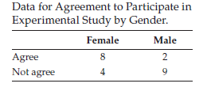
A=2, B=9, C=8, D=4
Observed and expected frequencies for agreement by gender. Cross-tabulation: gender and agreement.
p=0.024
Notes:
4/12 =0.333; 8/12=0.66; 4/13=0.308; 8/10=0.80; --------9/11=0.818; 2/11=0.182; 9/13=0.692; 2/10=0/20---------13/23=0.565; 10/23=0.435

Slide 8
The researchers should reject the null hypothesis that patient agreement to
participate in a clinical trial study on sleep disorders is independent of gender.
They can conclude that there is a statistically significant association of gender with willingness to participate in the study. More women (8) than men (2) agreed to participate. A bar chart showing the number of men and women who agreed to participate in the clinical trial is displayed below.

Slide 9
Wilcoxon-Mann-Whitney U Test
The Wilcoxon-Mann-Whitney U test is a counterpart to the parametric independent samples t-test for evaluating whether two samples were drawn from two different populations with equal means.
The Mann-Whitney test examines the medians of the distributions for two
samples to determine whether the median of one sample is larger (or smaller)
than the median of the other sample.
Test: The hypotheses for the comparison of two independent groups are:
Ho: The two samples come from identical populations
H1: The two samples come from different populations

Slide 10
Wilcoxon-Mann-Whitney U Test
Scores from both groups are combined and ranked in order of increasing size. The smallest score is ranked 1; the second smallest score is ranked 2, etc. The algebraic sign associated with the score (+ or –) is considered in the ranking so that negative scores are given lower ranks than positive scores.
The ranks in one group, say Group X, are summed and noted as the Wilcoxon value (W_{X}). Next, the ranks in the other group, say Group Y, are summed. These ranks may be noted as W_{Y}.
It is very important that as then scores are ranked, they retain their original group membership. The sum of the ranks for the two groups should be the same as the sum of the ranks for the combined groups.

Slide 11
The null hypothesis states that the ranks for the two groups are equal, or
the null hypothesis may state that there is no difference in the ranks for the
two groups.
Under a true null, the average ranks for the groups should be approximately equal. However, if the sum of the ranks for one group is either very large or very small when compared to the sum of the ranks for the other group, one may conclude that the samples were taken from two different populations

Slide 12
1. Rank the data by increasing values and label each rank by its group name or as an X or a Y so that the original identity of the data is not lost in the process.
2. Sum the ranks for each group.
3. Check that the sums of the ranks for the two groups combined are equal to the sum of the ranks for the combined group. The table in the previous slide
displays data for the first three steps of the procedure to calculate the Mann-Whitney test statistic.
The sum of the ranks for group X is 49 (n = 7). The sum of the ranks for group Y is 71 (n = 8). The sum of the ranks for the two groups is 49 + 71 = 120. Calculate the sum of ranks for both groups using the following formula:
Sum of ranks for Group X + sum of ranks for Group Y
= N (N + 1)/2 = 15(15 + 1)/2 = 240/2 = 120.
Conduct the statistical test for the null hypothesis. Recall that the null hypothesis tests the probability that the average ranks for Group X are equal to the average ranks for Group Y.

Slide 13
If there is no difference between the average ranks for the two groups, then the
average group ranks should be approximately equal.
However, if the sum of the ranks is quite different in size, then we may suspect
that the two groups were not from the same distribution. The two-tailed test is
used if we do not wish to predict the direction of the difference.
For the two-tailed test, the alternative hypothesis states that the probability that Group X is equal to Group Y ≠ 1/2. The expectation is that the groups will have equal distributions; thus 1/2 is used in the alternative hypothesis.
The test evaluates whether the probability is > ½; that a score from Group X
is larger than a score from Group Y.

Slide 14
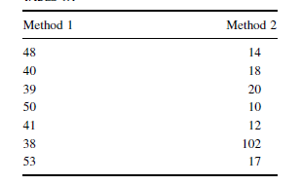
Example. The following data were collected from a study comparing two methods being used to teach reading recovery in the 4th grade. Method 1 was a pull-out program in which the children were taken out of the classroom for 30 min a day, 4 days a week.
Method 2 was a small group program in which children were taught in groups of four or five for 45 min a day in the classroom, 4 days a week. The students were tested using a reading comprehension test after 4 weeks of the program. The test results are shown in the Table below.

Slide 15
State the Null and Research Hypotheses
The null hypothesis states that there is no tendency of the ranks of one method to be systematically higher or lower than the other. The hypothesis is stated in terms of comparison of distributions, not means. The alternative hypothesis states that the ranks of one method are systematically higher or lower than the other. Our research hypothesis is a two-tailed, non-directional hypothesis because it indicates a difference, but in no particular direction.
The null hypothesis is
H_{O}: There is no tendency for ranks of one method to be significantly higher
(or lower) than the other.
H_{A}: The ranks of one method are systematically higher (or lower) than the
Other.

Slide 16
Compute the Test Statistic
First, combine and rank both data samples together. Next, compute the sum of ranks for each method. Method 1 is ΣR1 and method 2 is ΣR2.

Slide 17
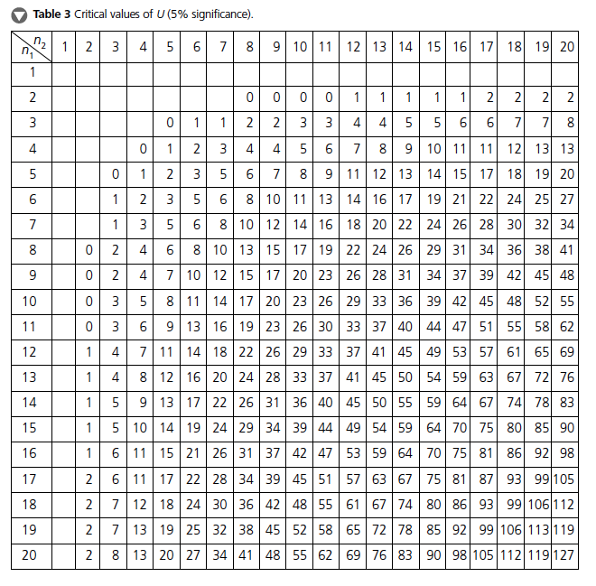

Slide 18
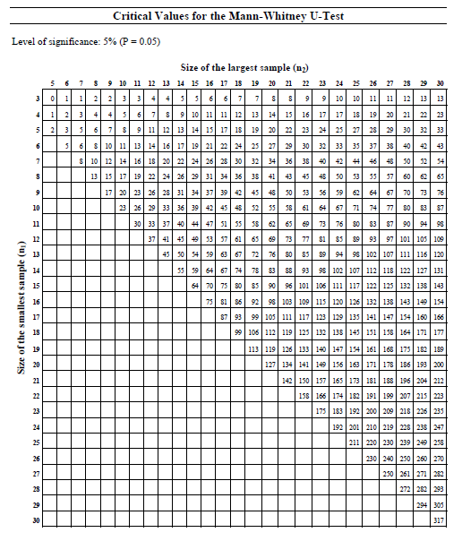

Slide 19
The critical values are found on the table at the point for n1 = 7 and n2 = 7. We set α = 0.05. The critical value for the Mann−Whitney U is 8. A calculated value that is less than or equal to 8 (U_test < U_crt) will lead us to reject our null hypothesis.
Compare the Obtained Value with the Critical Value The critical value for rejecting the null hypothesis is 8 and the obtained value is U = 7.
If the critical value equals or exceeds the obtained value, we must reject the null hypothesis.
If instead, the critical value is less than the obtained value, we must not reject the null hypothesis.
Since the critical value exceeds the obtained value, we must reject the null hypothesis.

Slide 20
Interpret the Results We rejected the null hypothesis, suggesting that a real difference exists between the two methods. In addition, since the sum of the ranks for method 1 (ΣR1) was larger than method 2 (ΣR2), we see that method 1 had significantly higher scores.
Reporting the Results Two methods were used to provide students with reading instruction. Method 1 involved a pull-out program and method 2 involved a small group program. Using the ranked reading comprehension test scores, the results indicated a significant difference between the two methods (U = 7, n1 = 7, n2 = 7, p < 0.05). The sum of ranks for method 1 (ΣR1 = 70) was larger than the sum of ranks for method 2 (ΣR2 = 35).
Therefore, we can state that the data support the pull-out program as a more effective reading program for teaching comprehension to 4th-grade children at this school.

Slide 21
CODE R
> data<-read.table("ex61.txt", header=TRUE)
> data
> wilcox.test(score ~ method, data=data)
Wilcoxon rank sum test
data: score by method
W = 42, p-value = 0.02622
alternative hypothesis: true location shift is not equal to 0

Slide 22
Researchers report the confidence interval for research data.
A confidence interval is an inference to a population in terms of an estimation of sampling error. More specifically, it provides a range of values that fall within the population with a level of confidence of 100(1 − α)%.
A median confidence interval can be constructed based on the difference between two independent samples. It consists of possible values of differences for which we do not reject the null hypothesis at a defined significance level of α.
The test depends on the following assumptions:
1. Data consist of two independent random samples: X1, X2, . . . , Xn from one
population and Y1, Y2, . . . , Yn from the second population.
2. The distribution functions of the two populations are identical except for possible location parameters

Slide 23
The previous comparison of teaching methods for reading recovery was repeated
with 5th-grade students. The 5th-grade used the same two methods.
Method 1 was a pull-out program in which the children were taken out of the classroom for 30 min a day, 4 days a week.
Method 2 was a small group program in which children were taught in groups of four or five for 45 min a day in the classroom, 4 days a week.
The students were tested using the same reading comprehension test after 4 weeks
of the program. The test results are shown in the table below.
State the Null and Research Hypotheses
The null hypothesis states that there is no tendency of the ranks of one method to be systematically higher or lower than the other. The hypothesis is stated in terms of comparison of distributions, not means.
The alternative hypothesis states that the ranks of one method are systematically higher or lower than the other. Our research hypothesis is a two-tailed, non-directional hypothesis because it indicates a difference, but in no particular direction.
H_{O}: There is no tendency for ranks of one method to be significantly higher (or lower) than the other.
H_{A}: The ranks of one method are systematically higher (or lower) than the other.

Slide 24
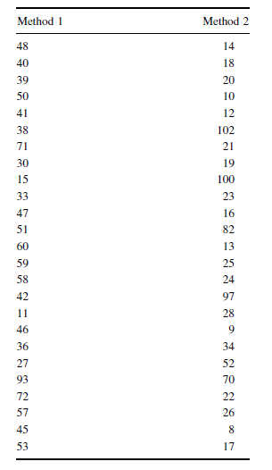

Slide 25
Set the Level of Risk (or the Level of Significance) Associated with the Null Hypothesis The level of risk, also called an alpha (α), is frequently set at 0.05. We will use α = 0.05 in our example. In other words, there is a 95% chance that any observed statistical difference will be real and not due to chance.

Slide 26
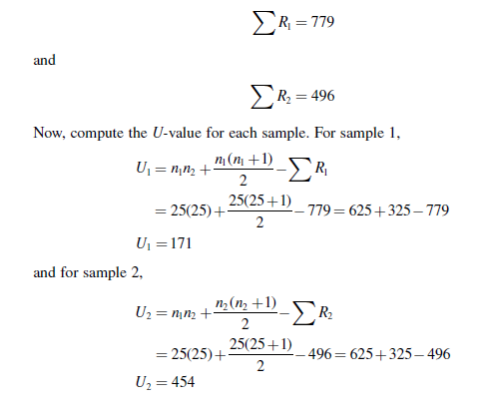
U_crt=211 > U_test=171, hence reject null hypothesis.
Notes:
http://www.real-statistics.com/statistics-tables/mann-whitney-table/

Slide 27
Since U=171 <211 critical value we reject the null hypothesis.
Interpret the Results. We rejected the null hypothesis, suggesting that a real difference exists between the two methods.
In addition, since the sum of the ranks for method 1 (ΣR₁) was larger than method 2 (ΣR₂), we see that method 1 had significantly higher scores.
At this point, the analysis is limited to identifying the presence or absence of a significant difference between the groups.
In other words, the statistical test’s level of significance does not describe the strength of the treatment.

Slide 28
Reporting the Results For this example, two methods were used to provide 5thgrade students with reading instruction.
Method 1 involved a pull-out program and method 2 involved a small group program. Using the ranked reading comprehension test scores, the results indicated a significant difference between the two methods (U = 171, n1 = 25, n2 = 25, p < 0.05). The sum of ranks for method 1 (ΣR₁ = 779) was larger than the sum of ranks for method 2 (ΣR₂ = 496).
Therefore, we can state that the data support the pull-out program as a more effective reading program for teaching comprehension to 5th-grade children at this school.

Slide 29
CODE R
> dat2<-read.table("ex62.txt", header=TRUE)
> wilcox.test(score ~ method, data=dat2)
Wilcoxon rank sum test
data: score by method
W = 454, p-value = 0.005495
alternative hypothesis: true location shift is not equal to 0

Slide 30
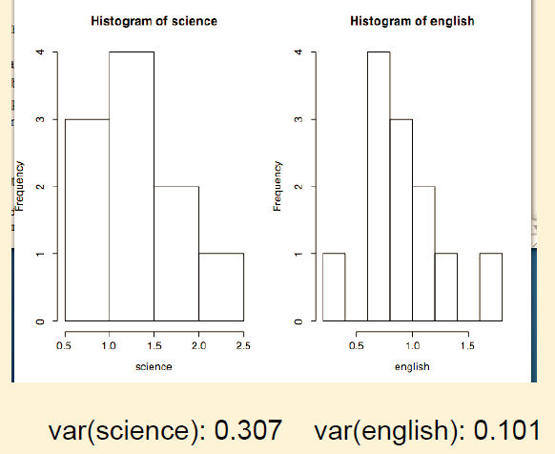
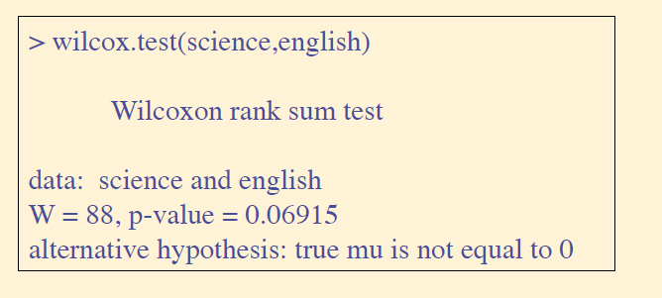
Example. A psychologist was interested in the verb-adjective ratio as an index of the habitual pattern of verbal expression for an individual. Science and English majors were compared using this index, by sampling some free writing from each and scoring.
Science: 1.32 2.30 1.98 0.59 1.02 0.88 0.92 1.39 1.95 1.25
English: 1.04 0.93 0.75 0.33 1.62 0.76 0.97 1.21 0.80 1.16 0.71 0.96

Slide 31
[1] Mann-Whitney test (c.f. two-sample t-test)
[2] Wilcoxon signed rank test (c.f. matched pairs test)
R uses wilcox.test for both, and uses context to figure out which you
want:
wilcox.test(x,y) Mann-Whitney
wilcox.test(x,y,paired=T) Wilcoxon

Slide 32
Example. Professor Testum wondered if students tended to make better scores on his test depending if the test were taken in the morning or afternoon. From a group of 19 similarly talented students. he randomly selected some to take a test in the morning and some to take it in the afternoon. The scores by groups were:
Morning Afternoon
89.8 87.3
90.2 87.6
98.1 87.3
91.2 91.8
88.9 86.4
90.3 86.4
99.2 93.1
94.0 89.2
88.7 90.1
83.9

Slide 33
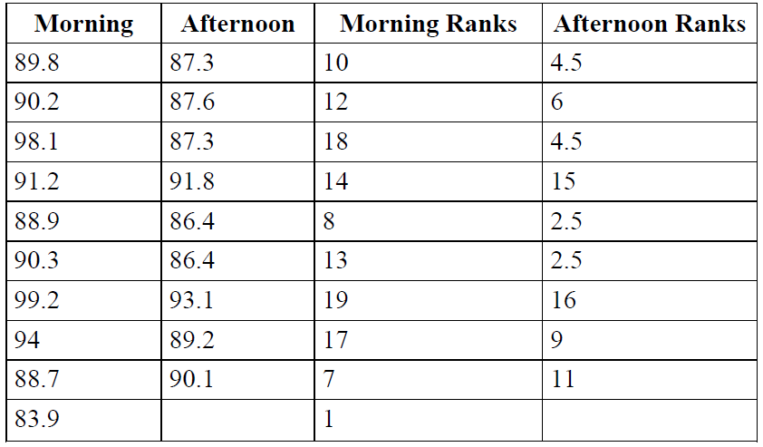

Slide 34
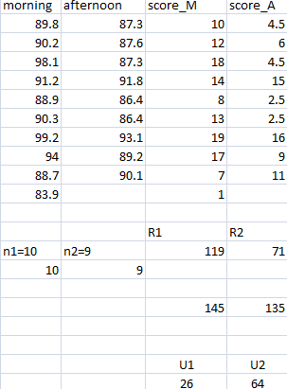
U_test=26 > U_crit=20, hence
Fail to reject H0!
> wilcox.test(score~ time, paired=F)
Wilcoxon rank sum test with continuity correction
data: score by time
W = 26, p-value = 0.1306
alternative hypothesis: true location shift is not equal to 0

